Slide 1
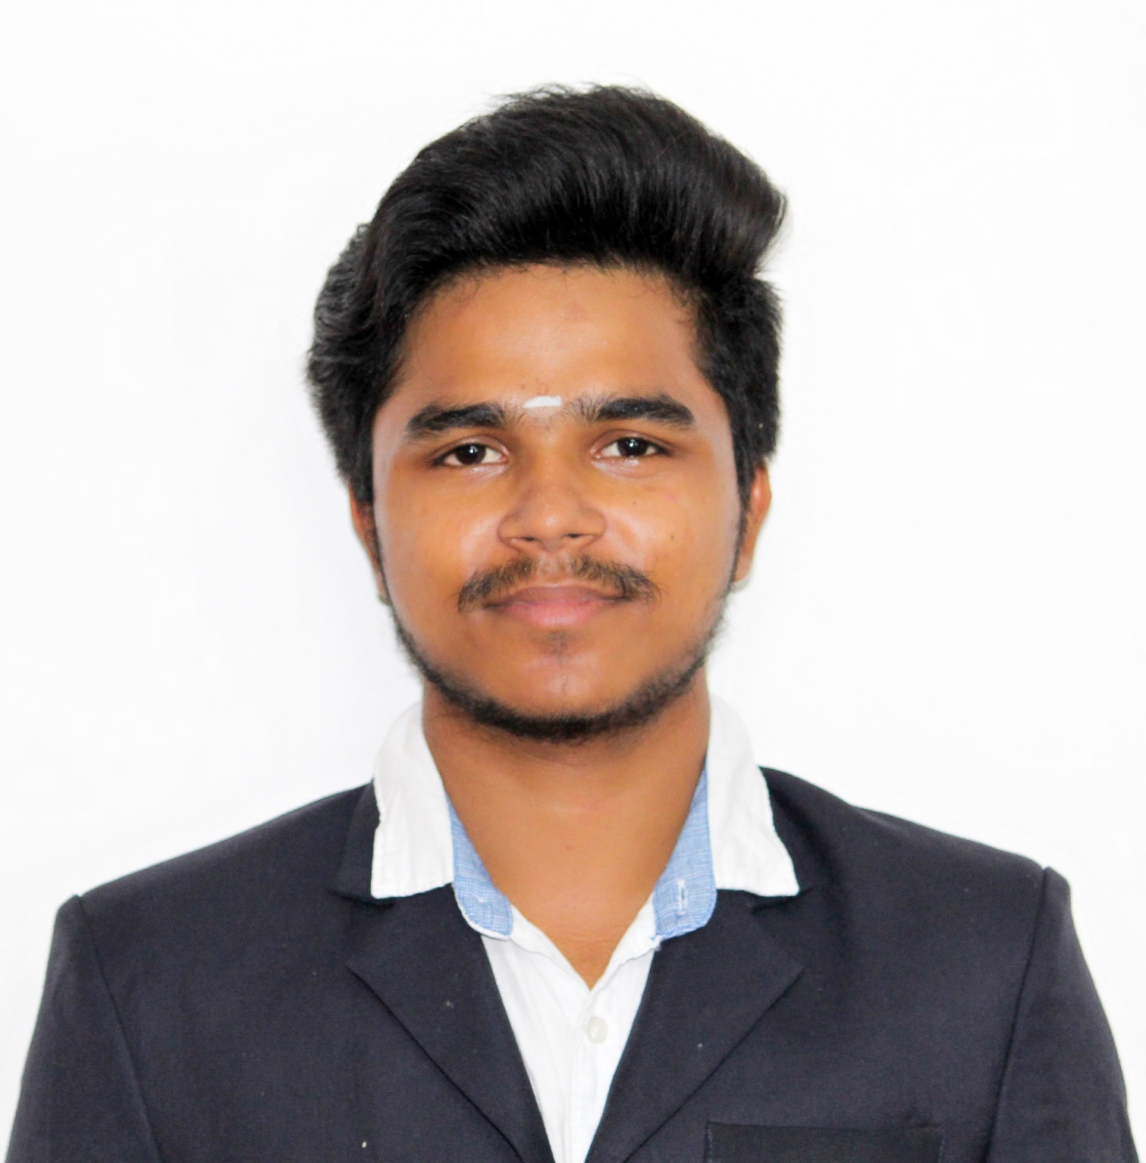
Hello All,
K.R.Goutham
B.E Mechatronics Engineer
I considered myself as an
Optimistic person
Team player
Social enthusiastic Person
Contact Info:
krgoutham21@gmail.com
+91-7448497767

Slide 2



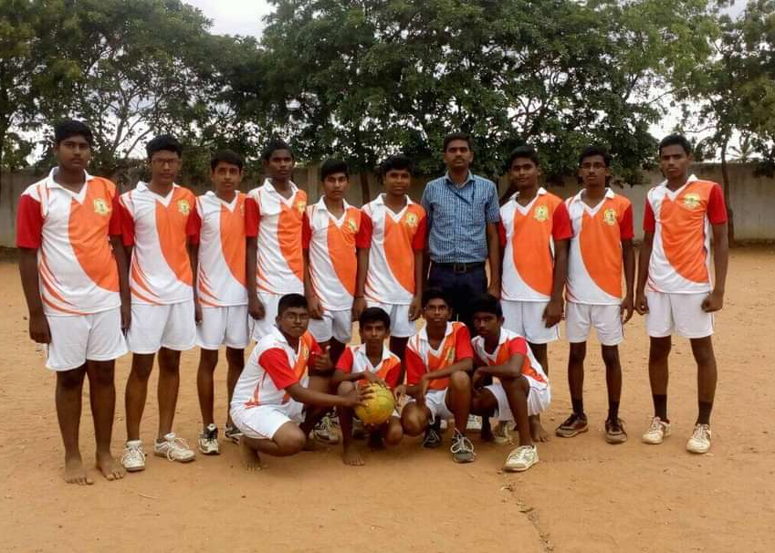
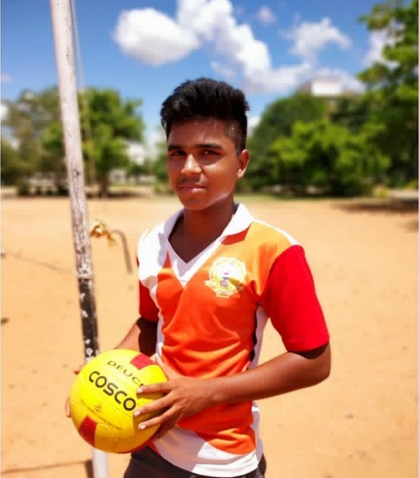
LEADERSHIP
SKILLS
Executive Head - Robotics club
Executive Member- Photography club
Active volunteer- NSS & Uliyin Uruvam
Strength:
I take everything in a positive way this help me to keep myself motivated even in the difficult situation.
I’m very flexible to work with interdisciplinary persons.
Extra curricular Activity:
Throw Ball

Slide 3
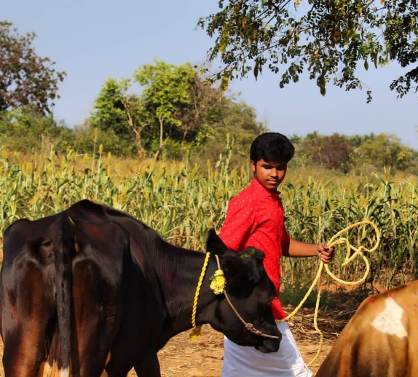
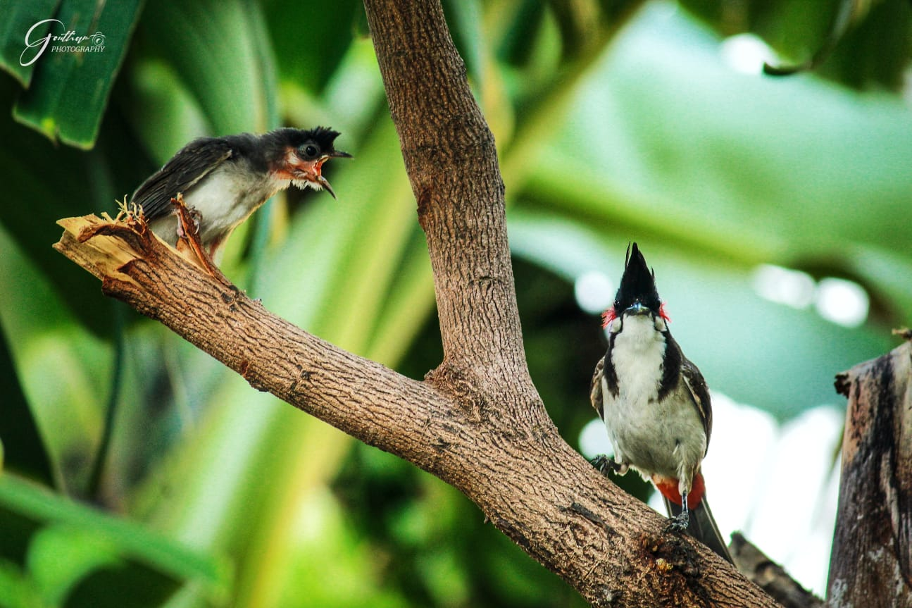
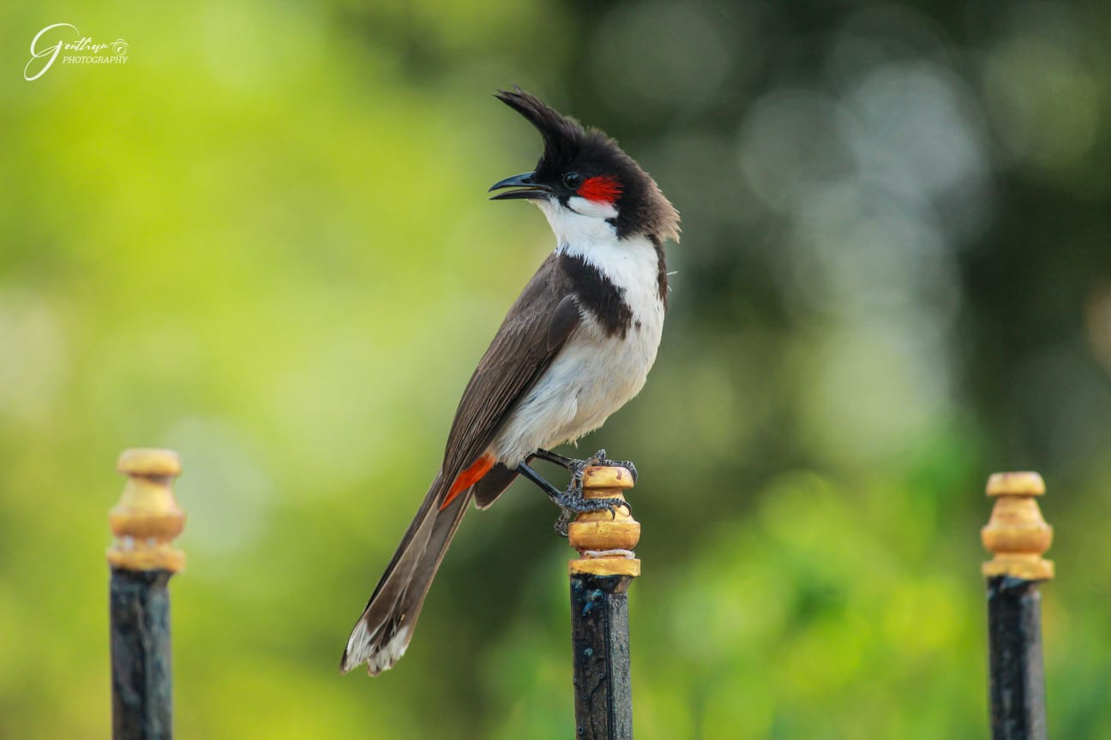

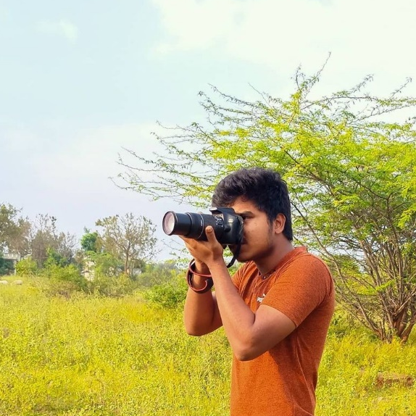
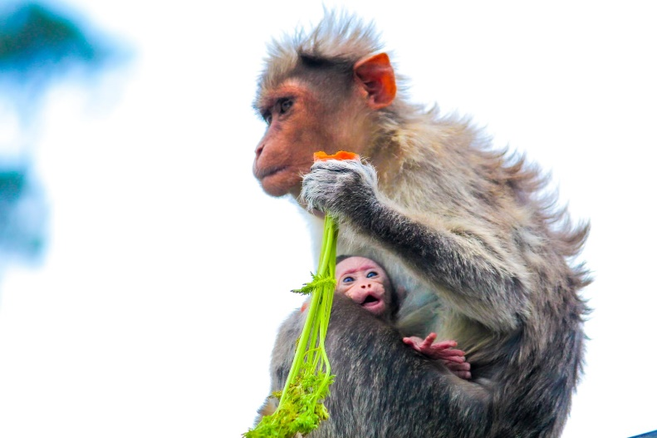
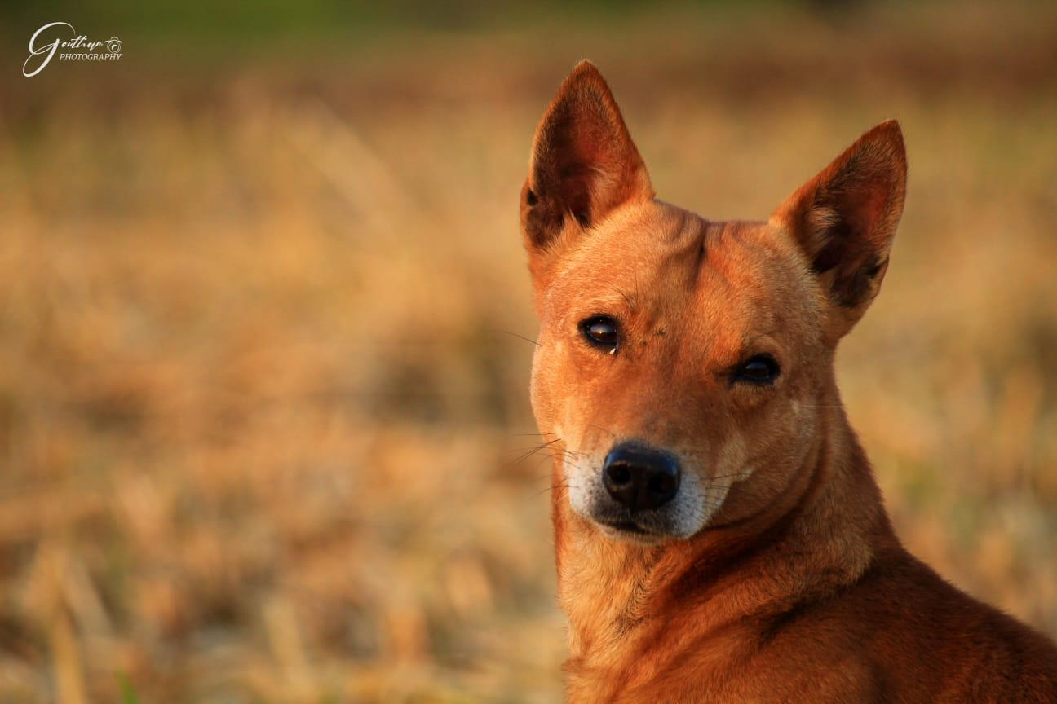
Short Term Goal
To get a job in a reputed company, where I can enhance my skills and gain knowledge.
Want to buy a brand new car for my Dear Mother.
Hobbies:
Photography
Cattle maintainer
Gardening
Long Term Goal:
My long-term plans are simple and straightforward. I want to move through the ranks and perform my duties as a team leader.

